Slide 1
Parallel Programming Assignment 2 - Xwindow
Annie Wu,
LSA Lab

Slide 2
Xwindow
For mac & MobaXterm user
For mac user, you need to install X11 and open it before you use it.
And you need to set “export DISPLAY=:0.0” on your terminal.
Example: ssh s100062101@140.114.91.171 –p 10000 –X
For putty user
Step1: Download and install Xming
Step2: Enable X11 forwarding for putty

Slide 3
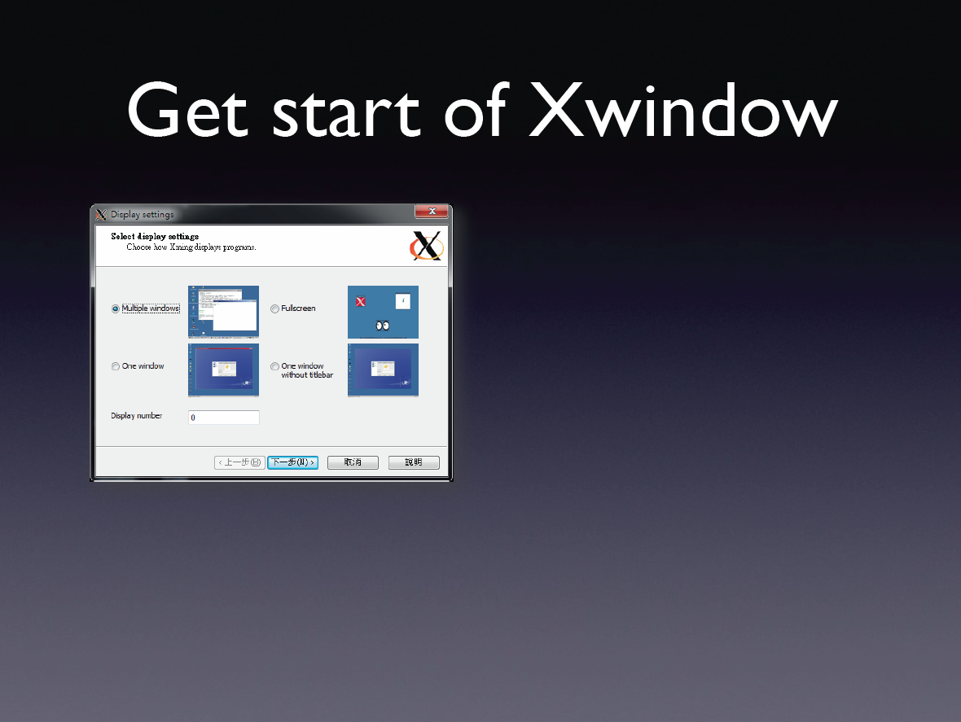

Slide 4
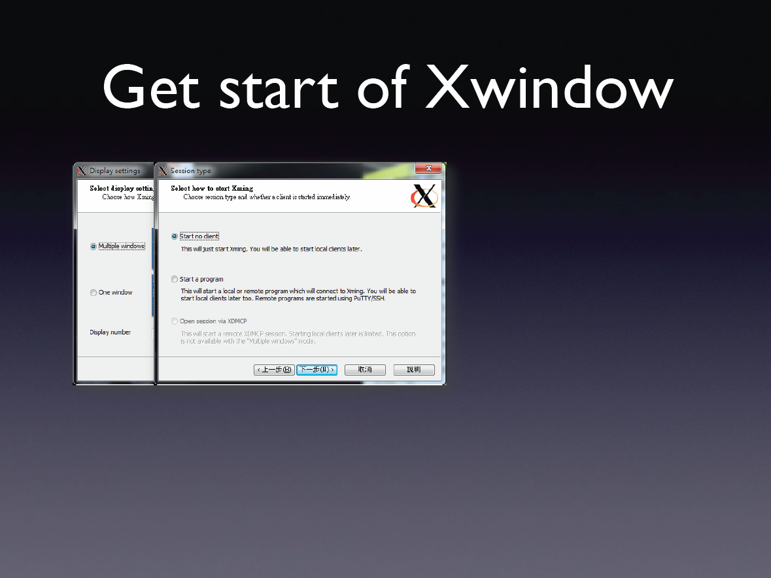

Slide 5
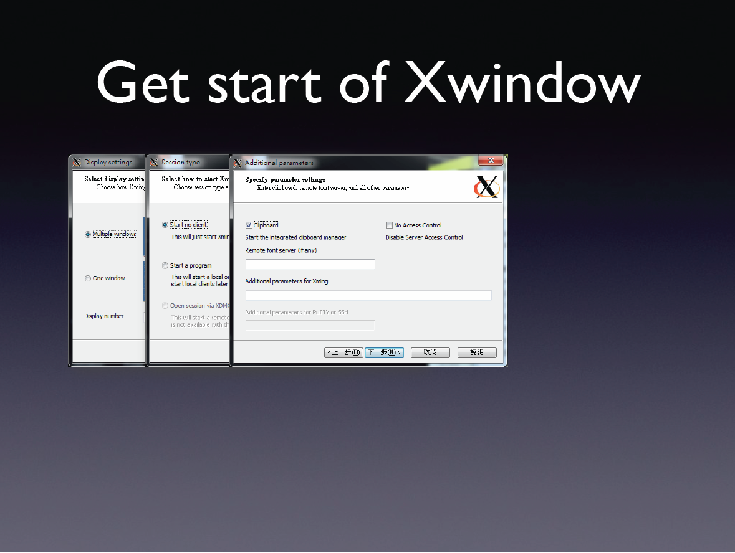

Slide 6
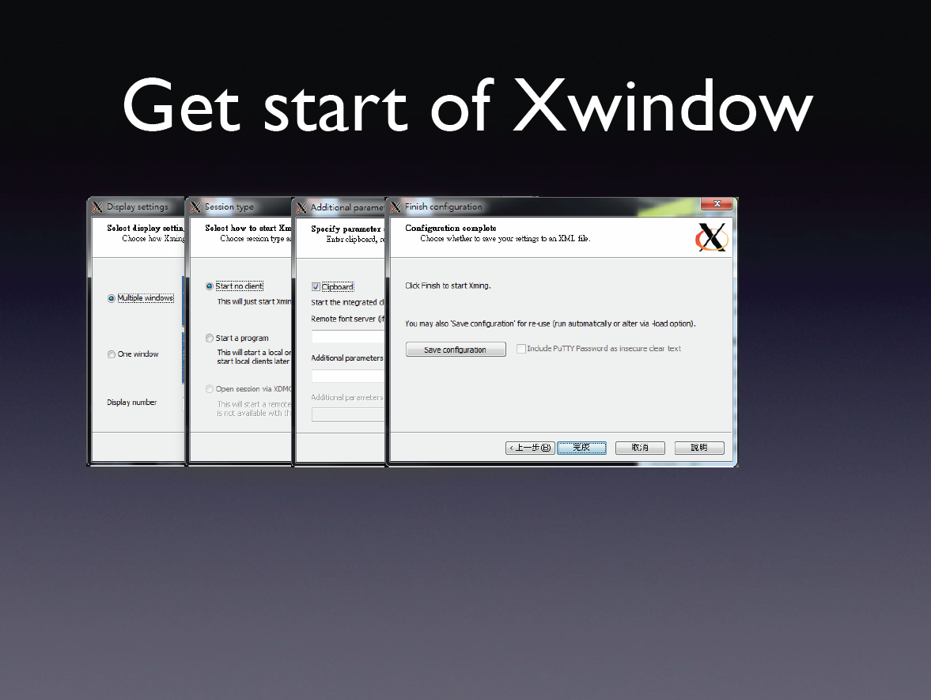

Slide 7
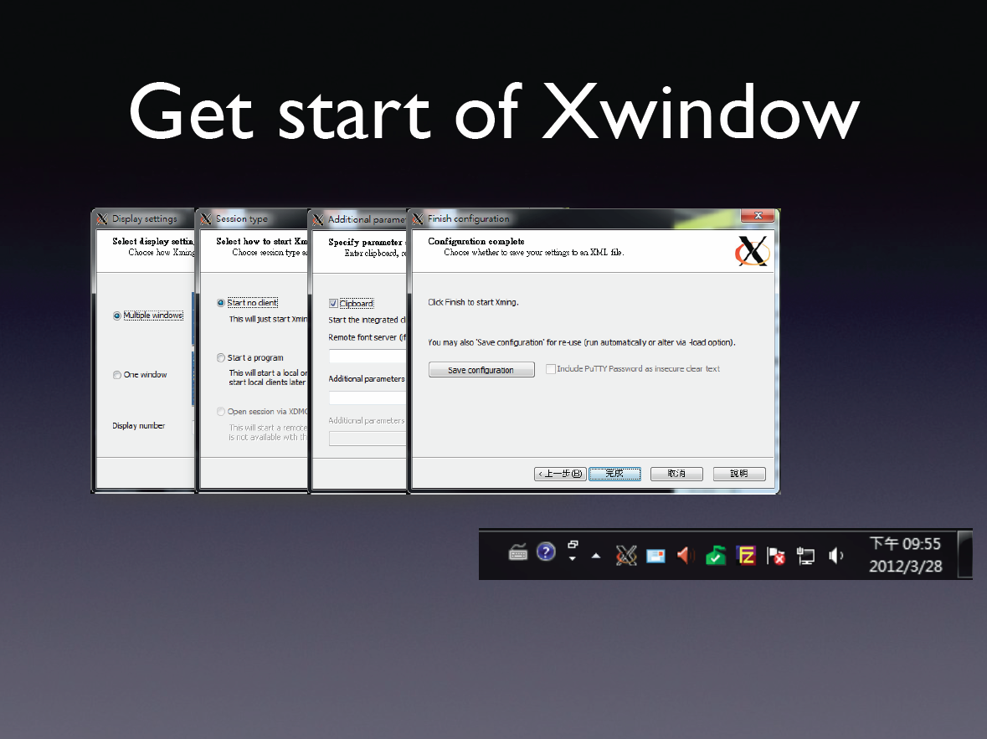

Slide 8
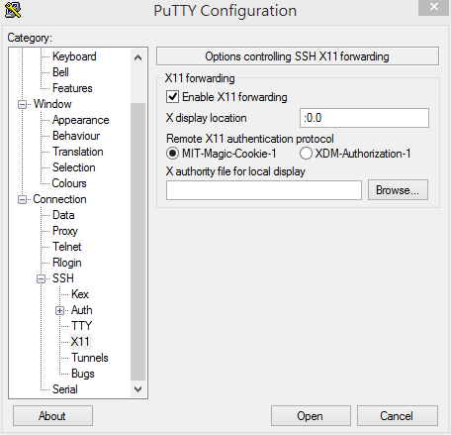
Open putty
Load host name
Choose X11
Enable x11 forwarding
Type “:0.0”

Slide 9
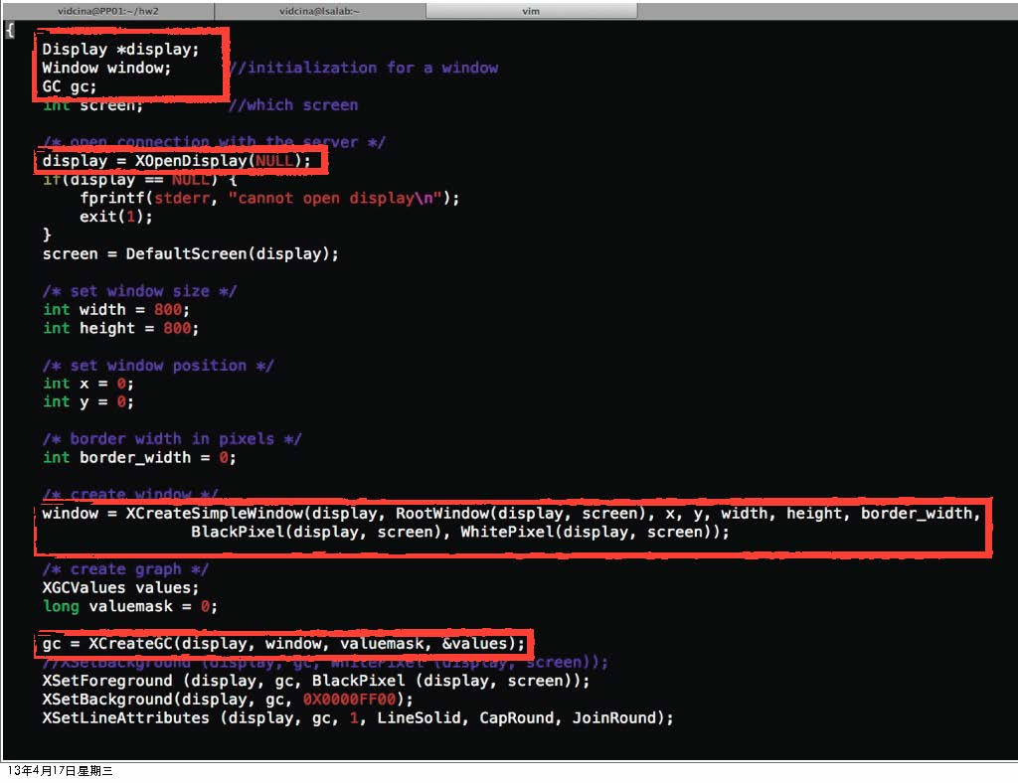

Slide 10
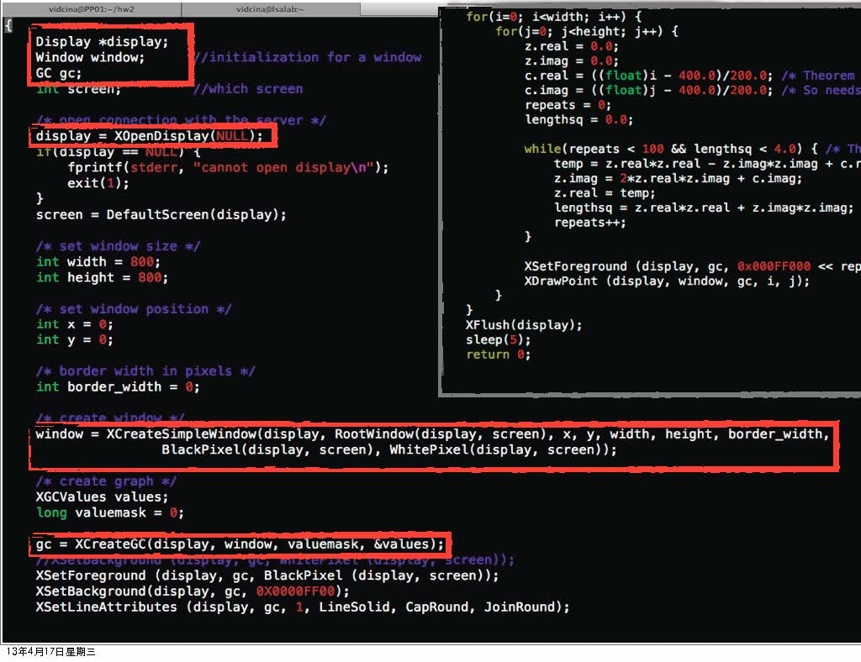

Slide 11
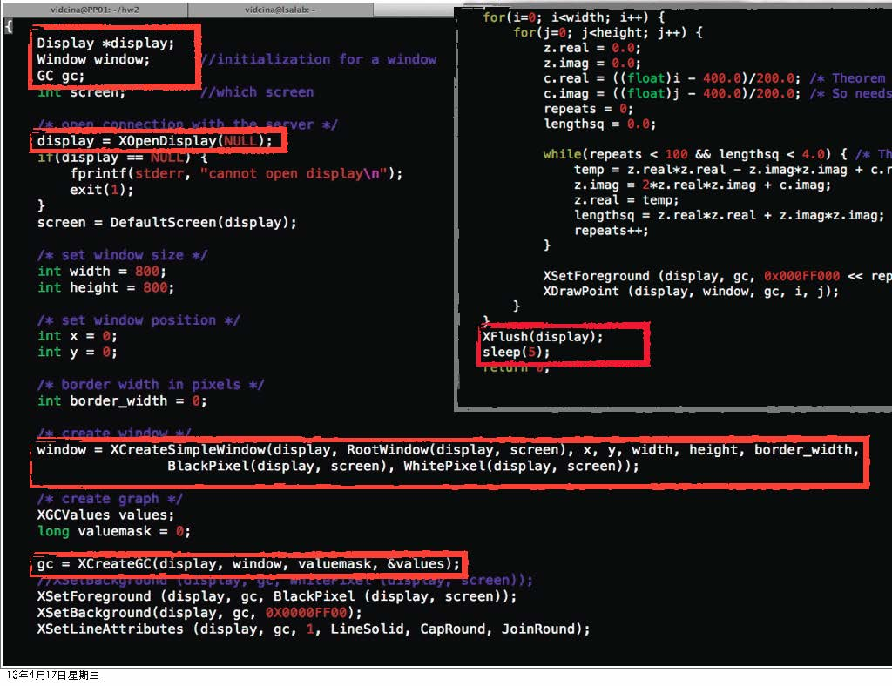

Slide 12
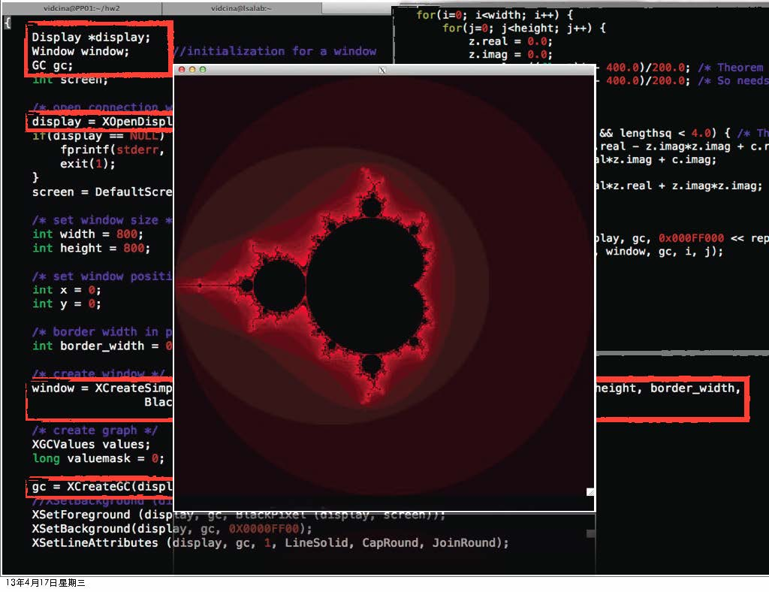

Slide 14
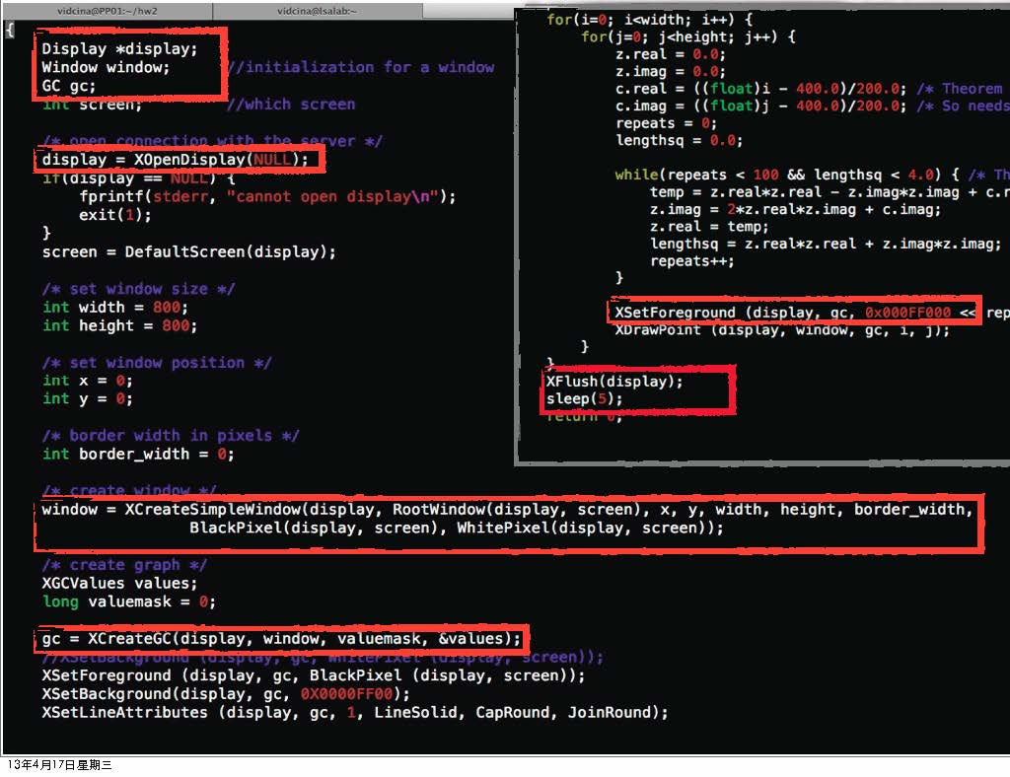

Slide 15
Reference
Xwindow setting for Mac user
https://www.sit.auckland.ac.nz/Remote_X11_testing
Xming download
http://sourceforge.net/projects/xming/files/latest/download
For more information of Xwindow, please see the attachment on iLMS
Lecture notes of Parallel Programming by Pf. Jerry Chou

